Slide 1

IBM Data Analysis
Capstone Project
Kyle McCallum
11/21/2025

Slide 2



OUTLINE
Executive Summary
Introduction
Methodology
Results
  Visualization – Charts
  Dashboard
Conclusion

Slide 3

EXECUTIVE SUMMARY
Purpose:
  Analyze Stack Overflow Developer Survey to understand trends
Method: Built three interactive dashboards covering current tech usage, emerging trends, and demographic distribution
  Included bar charts, tree maps, bubble charts, and geospatial mapping
Current Technology Trends:
  JavaScript, SQL, and TypeScript dominate programming languages.
  PostgreSQL, MySQL, and SQLite lead in database usage.
  AWS and Google Cloud are the most widely used platforms.
Future Technology Trends:
  Growing interest in TypeScript, Go, and Rust for next year.
  Redis, PostgreSQL, and cloud platforms such as AWS show rising demand.
  Web frameworks like React and FastAPI gain traction.
Demographics:
  Majority of respondents are aged 25–34 with Bachelor’s or Master’s degrees.
  Participation spans global regions, with concentration in North America, Europe, and India.

Slide 4

INTRODUCTION
Target Audience:
  Data professionals, analysts, and hiring managers
  Educators, curriculum designers, and tech leaders planning training or adoption strategies
  Organizations interested in workforce skills and technology adoption
Purpose of the Project:
  Analyze the Stack Overflow Developer Survey
  Identify current technology usage patterns and emerging future trends
  Understand developer demographics that shape these trends
Value of the Analysis:
  Highlights the most in-demand programming languages, databases, platforms, and frameworks
  Reveals which technologies developers plan to learn next
  Provides demographic context for interpreting technology preferences
  Supports data-driven decisions for skill development, hiring, and technology roadmap planning

Slide 5

METHODOLOGY
Data Source:
  Stack Overflow Developer Survey (subset provided for the capstone)
  Cleaned and prepared using Python (pandas)
Data Preparation & Wrangling:
  Removed or standardized long categorical labels
  Aggregated top 10 technologies across languages, databases, platforms, and frameworks
  Handled missing values and converted data types for visualization compatibility
Analytical Tools:
  Python (Pandas, Regex)
  Google Looker Studio for interactive dashboard creation
Dashboard Development:
  Built three dashboards:
    Current Technology Usage
    Future Technology Trends
    Demographics

Slide 6
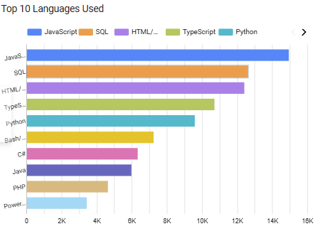
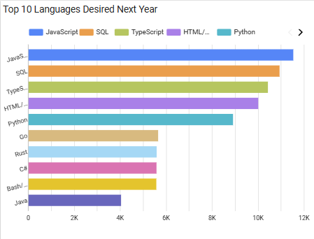
PROGRAMMING LANGUAGE TRENDS

Slide 7
PROGRAMMING LANGUAGE TRENDS - FINDINGS & IMPLICATIONS
JavaScript and Python remain the most widely used languages, reflecting their versatility across web and data workflows.
SQL continues to be a core skill due to its central role in data access and backend systems.
TypeScript usage is rising, indicating growing adoption of typed JavaScript ecosystems.
C#, Java, and C++ remain strong among enterprise and system-level developers.
Overall, the distribution reflects a strong emphasis on general-purpose languages and established multi-paradigm technologies.
TypeScript shows the largest anticipated growth, reinforcing its rising importance in modern web development.
Go and Rust appear prominently among desired languages, reflecting interest in high-performance, cloud-native, and systems-level development.
Python remains in strong demand, driven by continued growth in AI, data science, and automation fields.
Many developers intend to expand into strongly typed or low-latency languages, indicating a shift toward scalable and secure software architectures.
The future trend emphasizes performance, safety, and cloud-readiness over purely general-purpose usage.

Slide 8
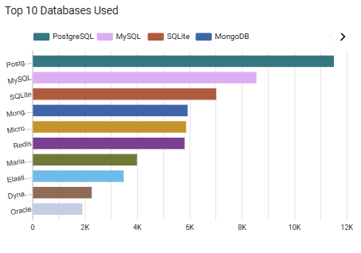
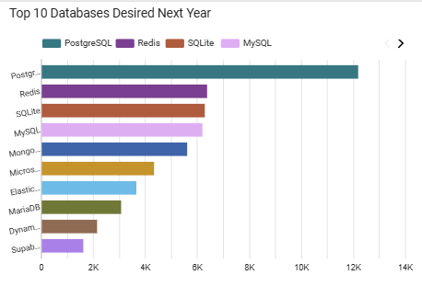
DATABASE TRENDS

Slide 9
DATABASE TRENDS - FINDINGS & IMPLICATIONS
PostgreSQL is the most widely used database, reflecting its strength in scalability, reliability, and open-source adoption.
MySQL and SQLite remain highly popular due to their ease of use, legacy support, and prevalence in web applications.
MongoDB shows strong usage among developers working with document-based or flexible schema designs.
Microsoft SQL Server maintains steady use in enterprise and corporate environments.
Overall usage suggests a balanced ecosystem where relational databases dominate, with NoSQL options filling specialized needs.
Redis is the most desired database moving forward, likely due to its speed, in-memory performance, and popularity in cloud architectures.
PostgreSQL continues to rank high in future demand, indicating sustained confidence in its long-term viability.
Developers show growing interest in MongoDB and SQLite, especially for lightweight, flexible data workflows.
The rise in interest for performance-optimized and cloud-native databases suggests a shift toward scalable, distributed system design.
Demand patterns indicate that developers are prioritizing speed, availability, and production-ready open-source tools in their future learning plans.

Slide 10
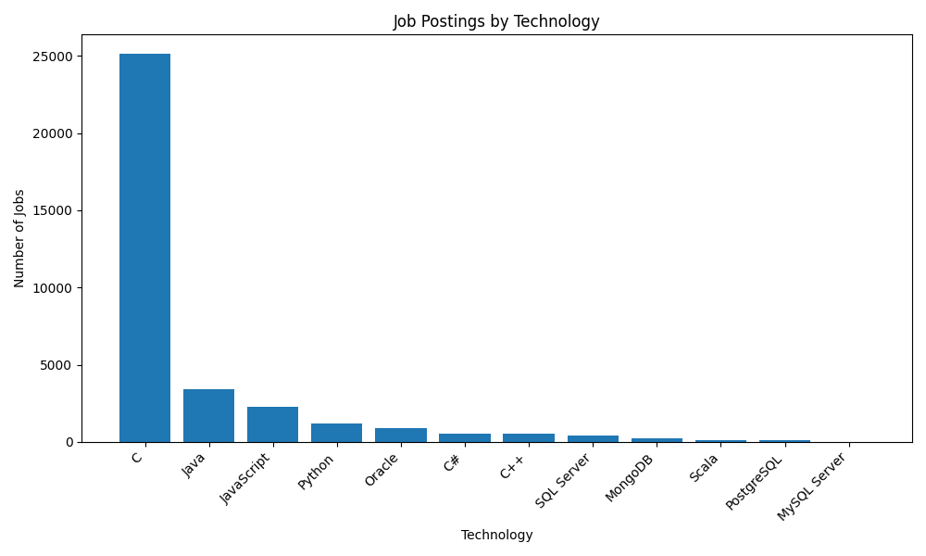

Slide 11
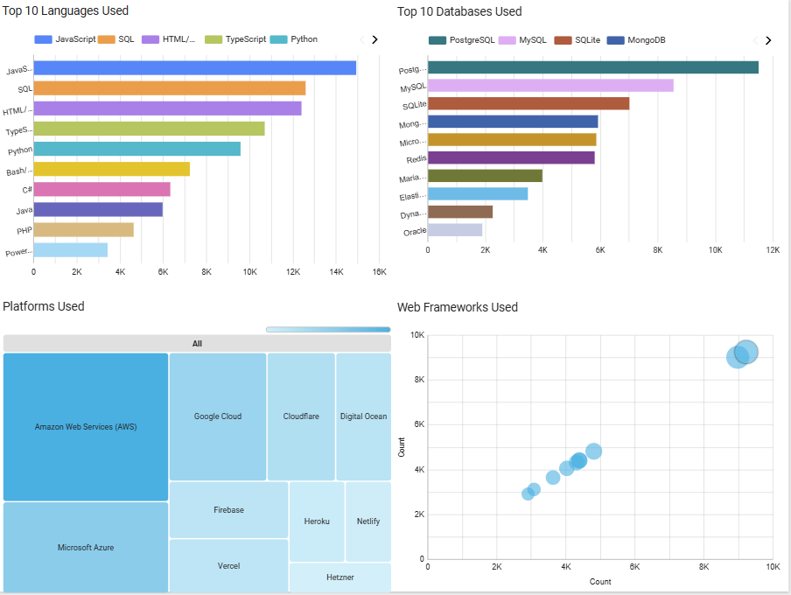
DASHBOARD TAB 1

Slide 12
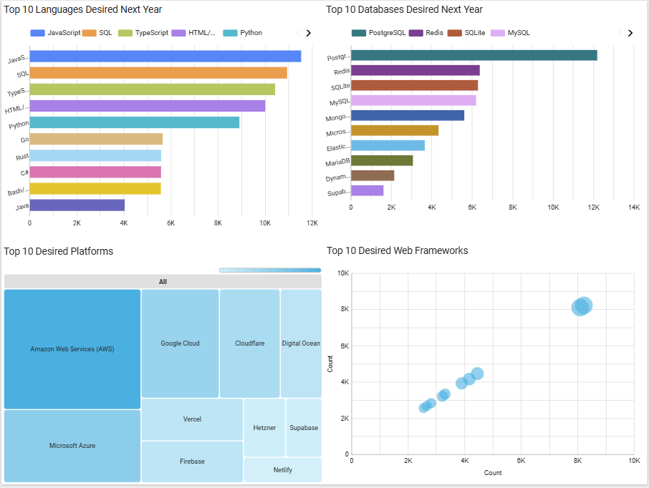
DASHBOARD TAB 2

Slide 13
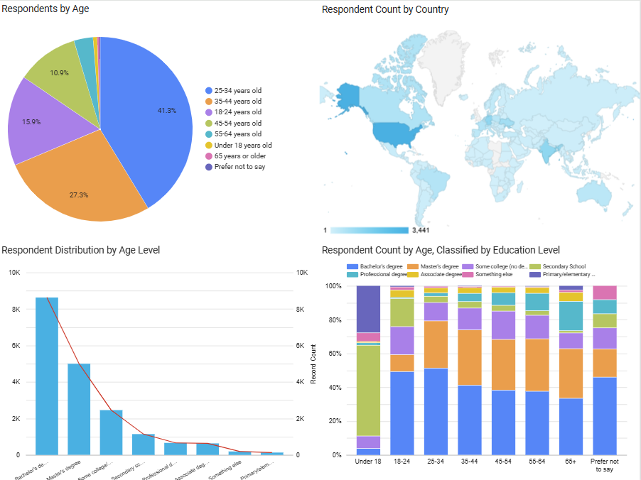
DASHBOARD TAB 3

Slide 14
OVERALL FINDINGS & IMPLICATIONS
General-purpose languages dominate current usage, with JavaScript, Python, and SQL forming the core developer toolkit.
Organizations should expect these skills to remain foundational across most roles.
Future learning trends show a shift toward performance and scalability, with rising interest in TypeScript, Go, and Rust.
This reflects increasing emphasis on cloud-native systems, type safety, and high-efficiency architectures.
Relational databases continue to lead, especially PostgreSQL and MySQL, due to reliability and broad industry adoption.
NoSQL systems like Redis and MongoDB show growing momentum, particularly in real-time and distributed applications.
Cloud platforms and automation tools are becoming critical skills, with AWS, Google Cloud, and modern frameworks ranking highly in desired technologies.
Indicates continued movement toward DevOps, microservices, and AI-driven workflows.
Demographics skew toward early-career developers, primarily ages 25–34 with Bachelor’s or Master’s degrees.
Training and hiring strategies should target this demographic while addressing regional skill variations.
The ecosystem is rapidly evolving, with developers actively preparing for tools that support scalability, reliability, and modern software engineering practices.
Businesses must align technology roadmaps with these shifts to remain competitive.

Slide 15

CONCLUSION
The analysis highlights strong continuity in core technologies, with JavaScript, Python, SQL, and PostgreSQL remaining central to modern development.
Future trends point toward performance-oriented and cloud-native tools, including TypeScript, Go, Rust, Redis, and AWS, reflecting industry movement toward scalable, secure architectures.
Developers are actively preparing for emerging technologies, indicating a healthy, forward-looking ecosystem with rapid skill evolution.
Demographic insights show a globally distributed but youthful workforce, dominated by early-career professionals with formal education pathways.
Overall, the findings support data-driven planning for hiring, curriculum design, and technology adoption strategies across organizations and developer communities.

Slide 16
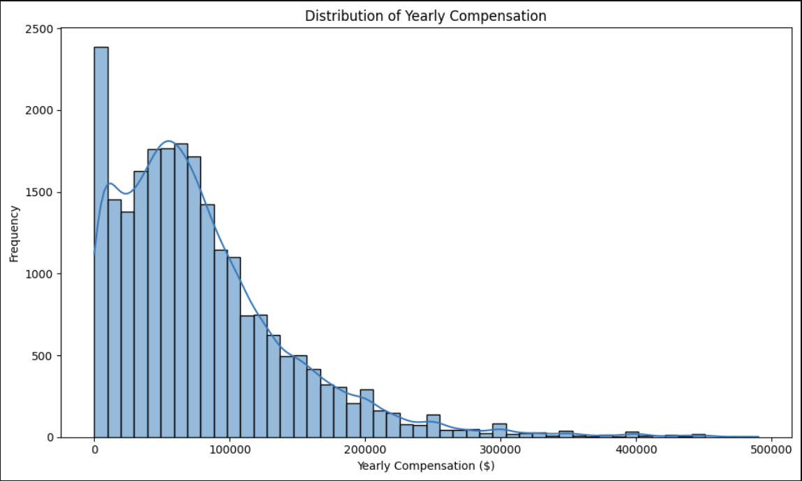
APPENDIX

